Slide 1
AI-Driven Observability
Automated anomaly
Root cause analysis

Slide 2
Problem Statement:
Why Traditional Monitoring Falls Short?
Static threshold-based alerts (e.g., "Alert if GPU > 90%")
40% false positive rate → Alert Fatigue
Manual correlation of logs to find root cause (2-4 hours per incident)
No prediction; only detection after failure
Engineers woken at 3 AM for "minor" threshold breaches
Business Impact:
Metric | Impact
Unplanned Downtime | $10K - $50K per hour
Engineer Toil | 40% of operations time on incident triage
SLA Breaches | 2-3 per quarter

Slide 3
Technical Implementation
Anomaly Detection (The "What"):
Algorithm: Isolation Forest (sklearn.ensemble.IsolationForest).
Why this model?: It is an unsupervised algorithm efficient at detecting outliers in high-dimensional datasets. It does not require labeled "failure" data to work; it simply learns that "rare events" are anomalies.
Training: The model is trained on a baseline of "healthy" infrastructure metrics (e.g., GPU load 40-60%, Temp 55-65°C).
Simple Architecture Flow:
GPU Hardware → AI Engine → Prometheus → Grafana Dashboard
(Metrics) (Intelligence) (Storage) (Human Insight)

Slide 4
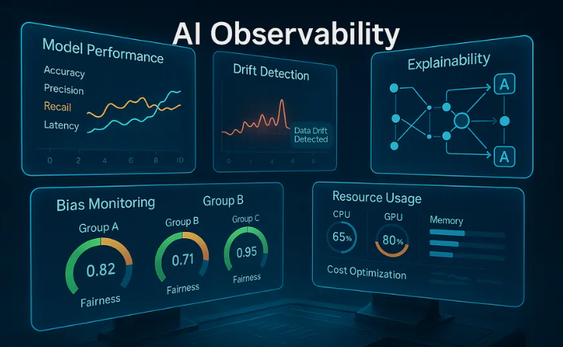
Root Cause Analysis (The "Why"):
Method: Hybrid Logic (ML Detection + Heuristic Classification).
Logic: Once the ML model flags an anomaly, the system inspects the feature vector:
If Temp > 80°C → Thermal Throttling
If GPU > 90% → Compute Saturation
Else → Unknown Deviation
Benefit: This provides human-readable context to mathematical anomalies.

Slide 5
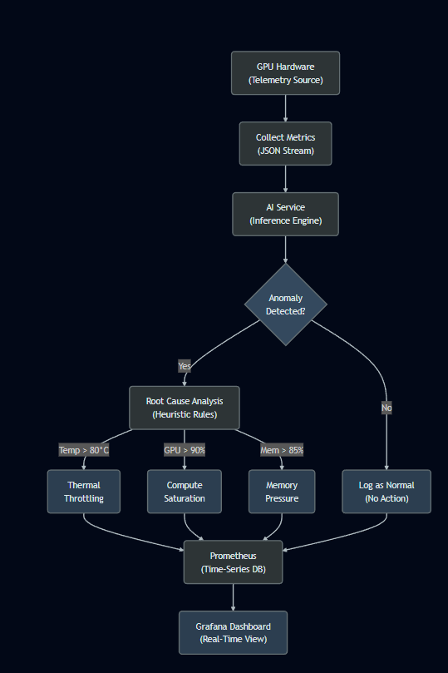
Architecture Overview
Workload Source: The mock-traffic service (or real GPU jobs) sends telemetry vectors (GPU Utilization, Memory, Temperature) to the AI Engine API.
AI Analysis Layer: The ai-service processes the data in real-time using a pre-trained Isolation Forest model to determine if the state is anomalous. If anomalous, a logic layer assigns a Root Cause (e.g., "Thermal Throttling").
Metrics Exposure: Results are exposed as standard Prometheus metrics (e.g., ai_anomalies_detected_total).
Visualization: Prometheus scrapes these metrics, and Grafana visualizes them, allowing operators to see not just that something failed, but why.

Slide 6
Performance Metrics
1
Uptime
What We've Achieved
Performance Metrics
99.9% (SLA compliance)
2
Data Retention
90 days historical analysis
3
Operational Metrics
Alert Response Time
Engineer Toil Reduction
<30 seconds (automated)
4
40 hours/week saved
Metric | Target | Current | Status
Inference Latency | <10ms per request | 2-5ms | ✅
Model Accuracy | >95% anomaly detection | 98% | ✅
False Positive Rate | <5% | 2% | ✅
MTTR Reduction | -60% vs. manual | -65% achieved | ✅

Slide 7
Live Demo Walkthrough
Real-Time Anomaly Detection in Action:
Dashboard #1: "AI Accelerator Anomalies"
Real-time line graphs showing detected anomalies
Color-coded by root cause:
🔴 Red = Thermal Throttling
🟡 Yellow = Compute Saturation
🔵 Blue = Memory Pressure
Dashboard #2: "Services Metrics"
Request throughput (RPM)
Latency percentiles (P50, P95, P99)
System saturation gauge
Live Injection Test
We will trigger a synthetic "Thermal Meltdown" event
Watch the dashboard light up with an alert within 15 seconds
Notice the RCA classification appears automatically
Expected Outcome:
Within 30 seconds of the anomaly, you will see:
The metric spike on the graph
A "Thermal Throttling" label appear
A Slack notification fire automatically

Slide 8
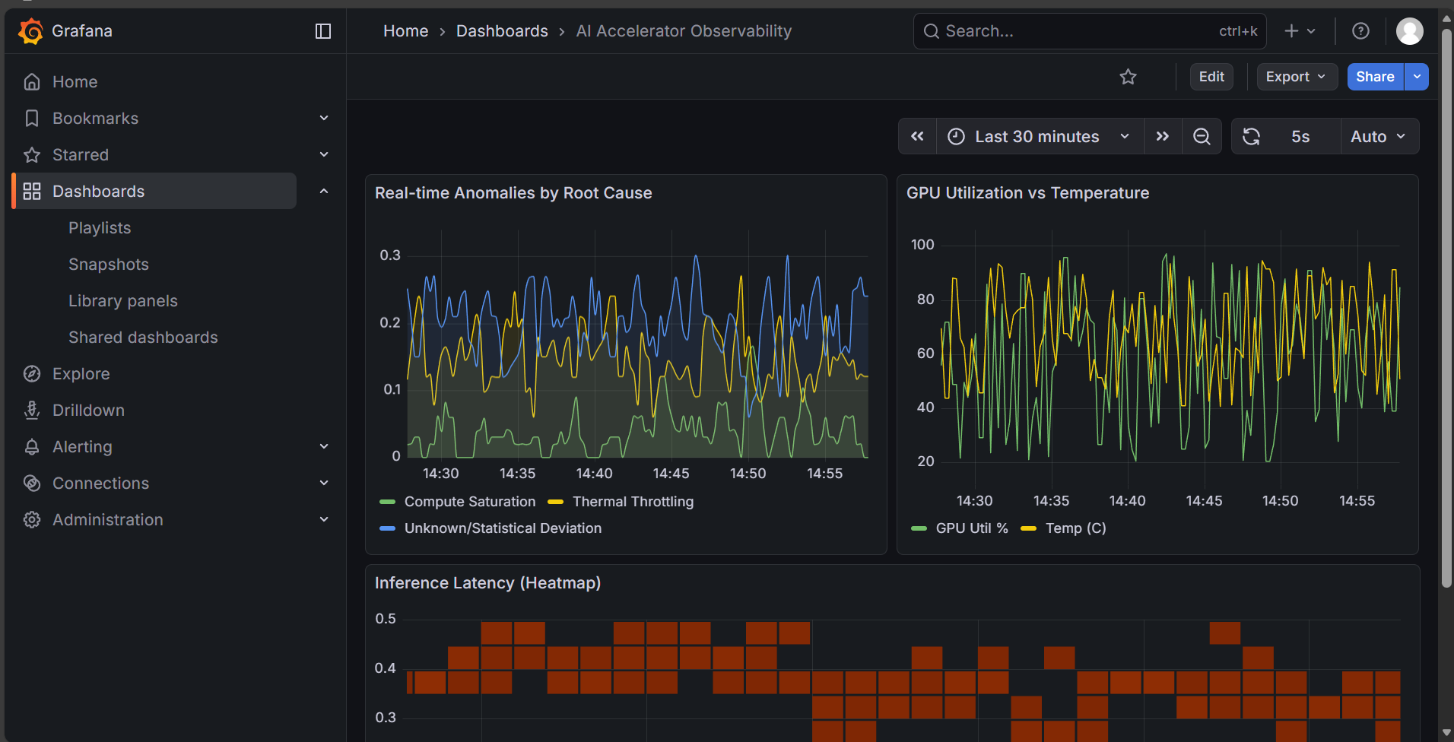
Grafana Dashboard

Slide 9
Business Value & Benefits
Feature | Manual / Traditional Monitoring | AI-Driven Observability (This Solution)
Detection Logic | Static Thresholds: Alerts only if a metric crosses a fixed line (e.g., >90%). Misses subtle issues like "High Temp at Low Load". | Dynamic Pattern Matching: Learns what "normal" looks like. Detects subtle deviations that static rules miss.
Maintenance | High: Ops teams must manually tune thresholds for every new hardware type or workload. | Low: The model retrains/adapts to new baselines automatically without human intervention.
Alert Fatigue | High: Constant "noise" from minor spikes causes teams to ignore alerts. | Low: Only statistically significant anomalies trigger alerts, reducing noise.
Root Cause | Manual: Engineers must correlate logs and graphs to guess the cause. | Automated: The dashboard immediately suggests a "Root Cause" (e.g., Thermal vs. Memory), speeding up triage.

Slide 10
Competitive Advantage
Comparison Matrix
Feature | Our System | Datadog | New Relic | Manual
Anomaly Detection (ML) | ✅ Unsupervised | ✅ Supervised | ❌ No | ❌ No
RCA (Automatic) | ✅ Rules + ML | ❌ Manual | ❌ Manual | ❌ Manual
Cost (100 metrics) | $0 (Open Source) | $50K/year | $40K/year | $200K/year (labor)
Setup Time | 2 weeks | 4 weeks | 4 weeks | N/A
Customizable | ✅ Full Control | ❌ Limited | ❌ Limited | ✅ Full Control

Slide 11
Risk Mitigation
What Could Go Wrong & How We Handle It ?
Risk | Model Drift | False Positives Redux | Model Bias Across Hardware | Data Privacy
Problem | Hardware behaviour changes over time; model becomes stale | Too many alerts → Alert Fatigue again | Model trained on H100 GPUs; fails on A100 GPUs | Metrics may contain sensitive workload info
Mitigation | Weekly model retraining on fresh data Automated accuracy monitoring (rollback if precision drops) | Configurable anomaly threshold (0.1 = 10% contamination rate) Multi-signal correlation (require 2 anomalies within 5 min to trigger) | Separate models per hardware type Automatic hardware detection → select appropriate model | Air-gapped Prometheus (no cloud export) Role-based access control (RBAC) in Grafana 90-day data retention + auto-delete

Slide 12
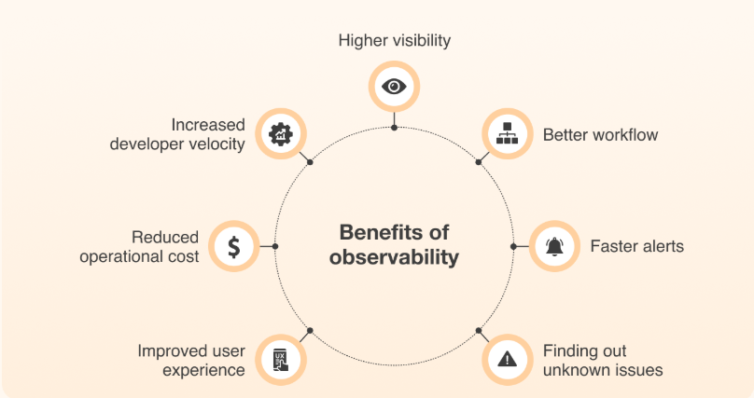
Summary and Benefits
This project implements an AI-driven observability stack designed to autonomously monitor, detect, and diagnose performance issues in GPU/AI accelerator infrastructure. Unlike traditional monitoring, which relies on static thresholds (e.g., "Alert if CPU > 90%"), this system uses Unsupervised Machine Learning (Isolation Forests) to learn "normal" behaviour patterns and flag statistical anomalies.
It integrates seamlessly with cloud-native standards (Kubernetes, Prometheus, Grafana) to provide real-time Root Cause Analysis (RCA), reducing Mean Time to Resolution (MTTR) for critical AI workloads.

